Slide 1
PROJECT TITLE
EMPLOYEE MANAGEMENT SYSTEM
Under the guidance of,
Trainer: NISHI
Presented By,
SAHIL KHAN
CHANDAN K
SRI SANJAY

Slide 2
PROJECT REQUIREMENTS
Creating a web application for employee management system where admin should be able to get:
Get all the employees
Add a new employee
Update an employee
Delete an employee
Details of an employee
Searching by name of an employee

Slide 3
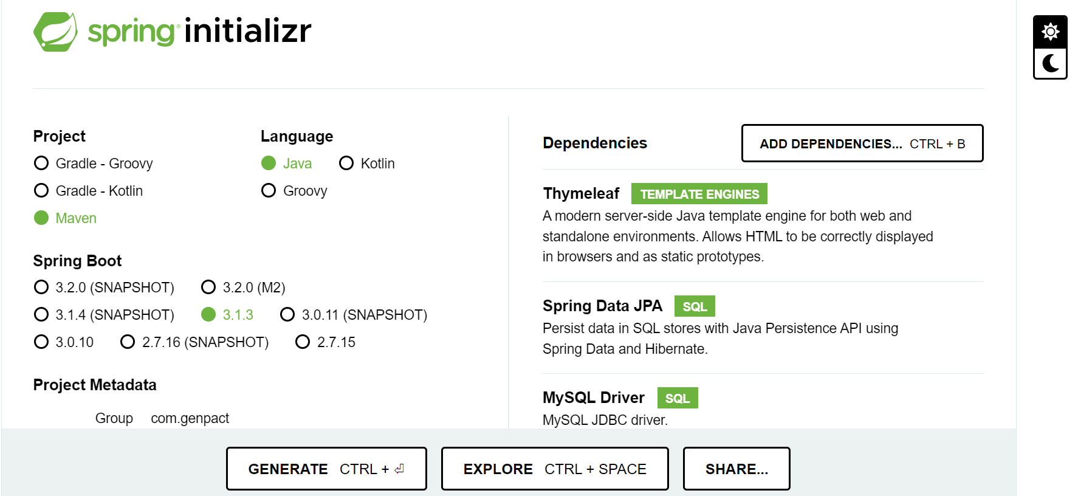
PROJECT SETUP

Slide 4
System Architecture
Spring Boot
Data layer (JPA entities, repositories).
Service layer.
Controller layer
Thyemleaf templates for the view layer.

Slide 5
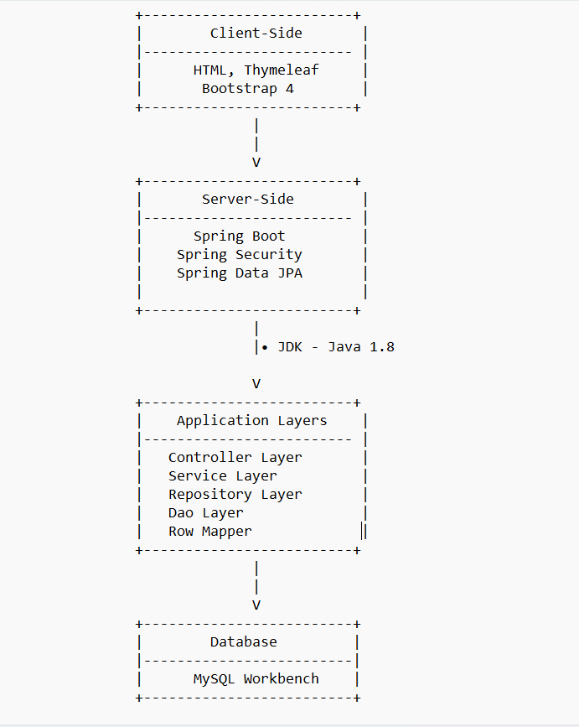
Layered Architecture

Slide 6
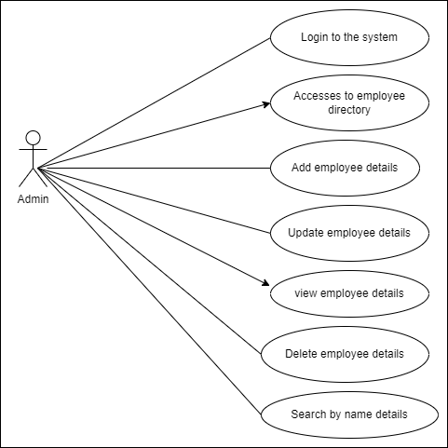
Use Case Diagram

Slide 7
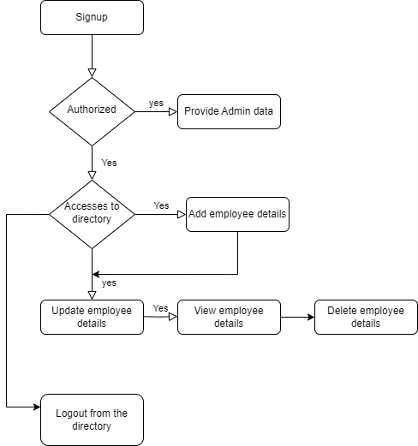
System Flow Architecture

Slide 8
User Interface (UI)
Admin login page.
Employee directory page.
Forms for adding/updating/deleting employees and their details.

Slide 9
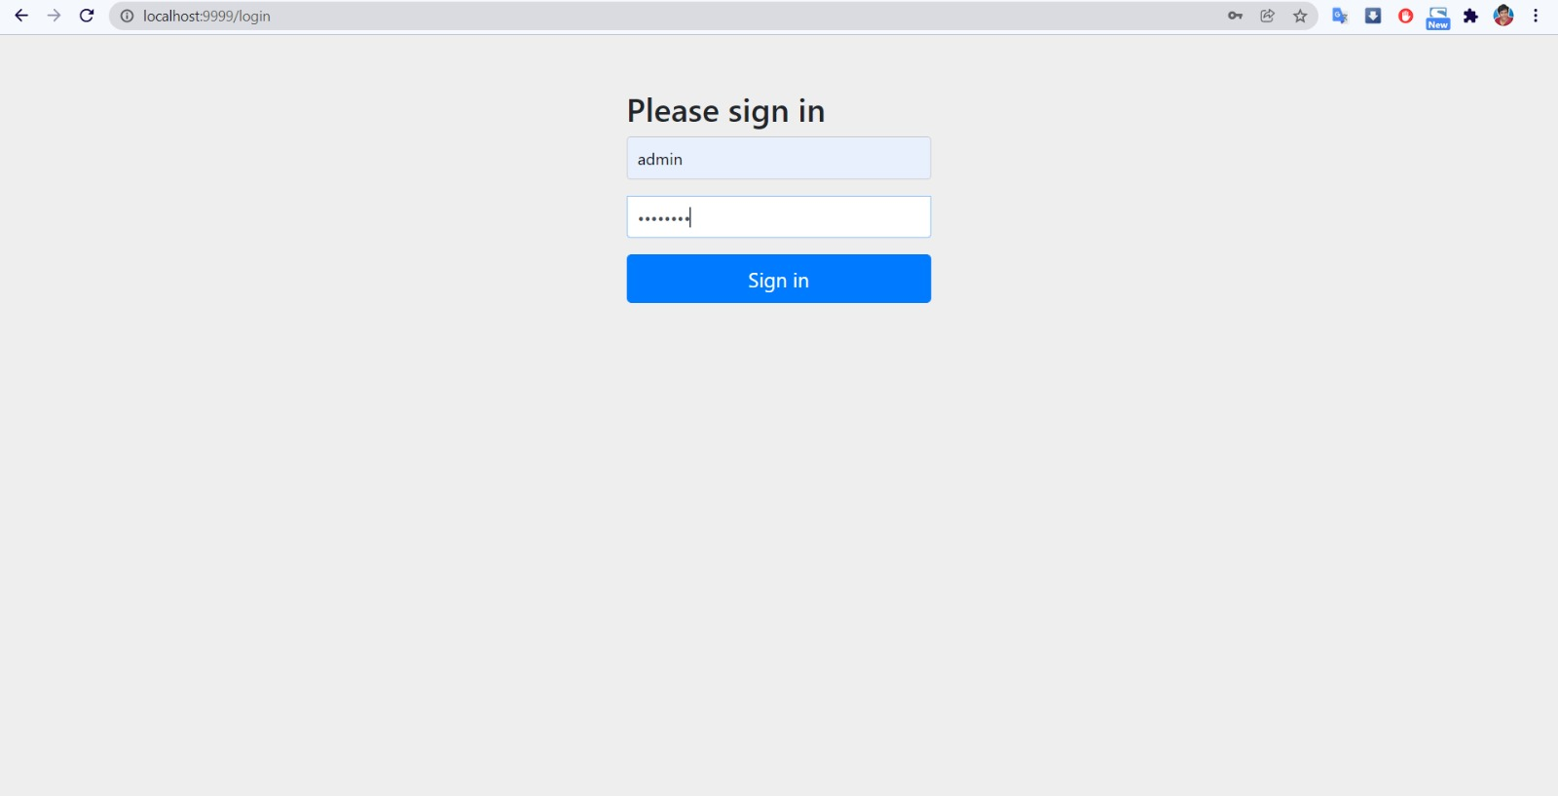

Slide 10
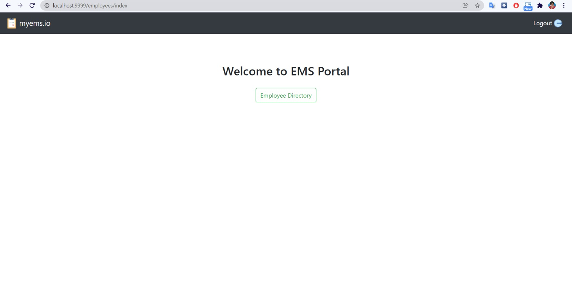
UI

Slide 11
Database Schema
Employee table
Employee ID
First Name
Last Name
Joining Date
Retired Date
Email ID
The database can be extended to include additional features and tables as the system evolves.
Database Connectivity:
Used Java JDBC and Spring Data JPA to connect to the database. Spring Data JPA simplifies database operations and provides object-relational mapping (ORM) capabilities.

Slide 12
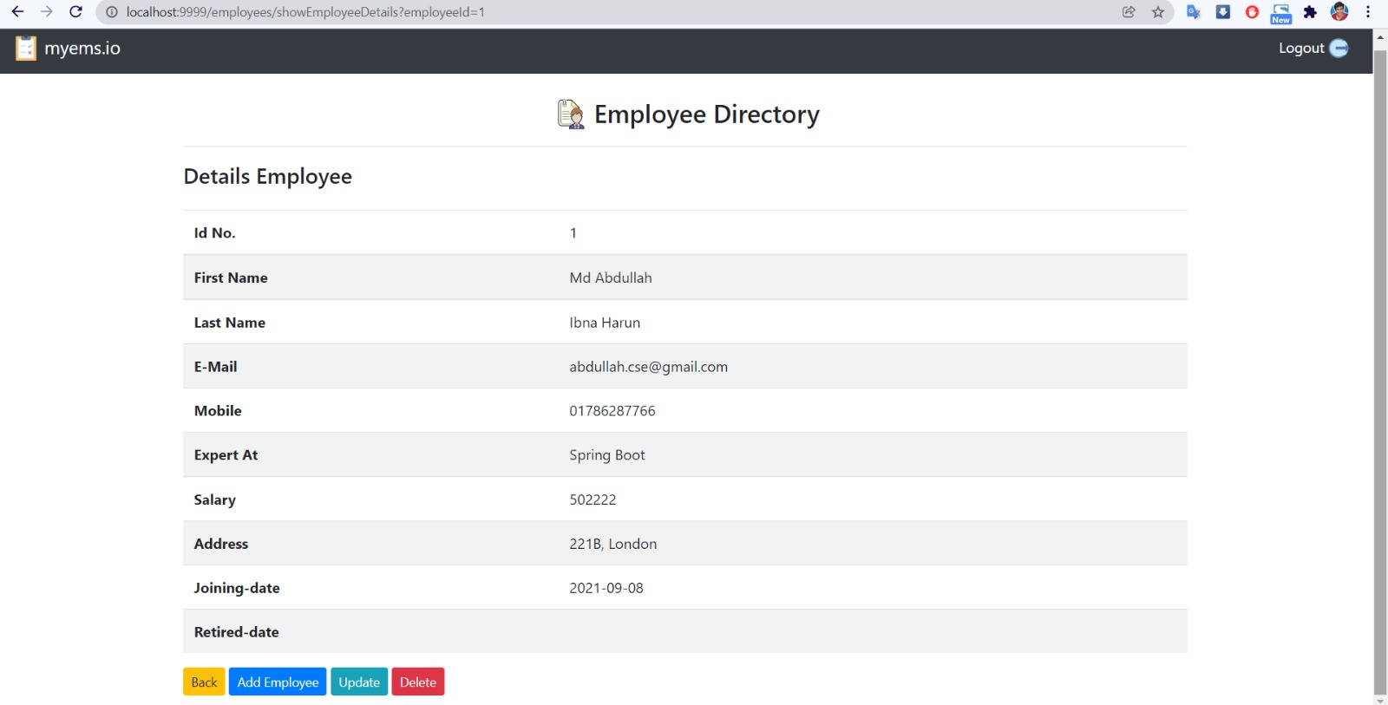
Employee directory

Slide 13
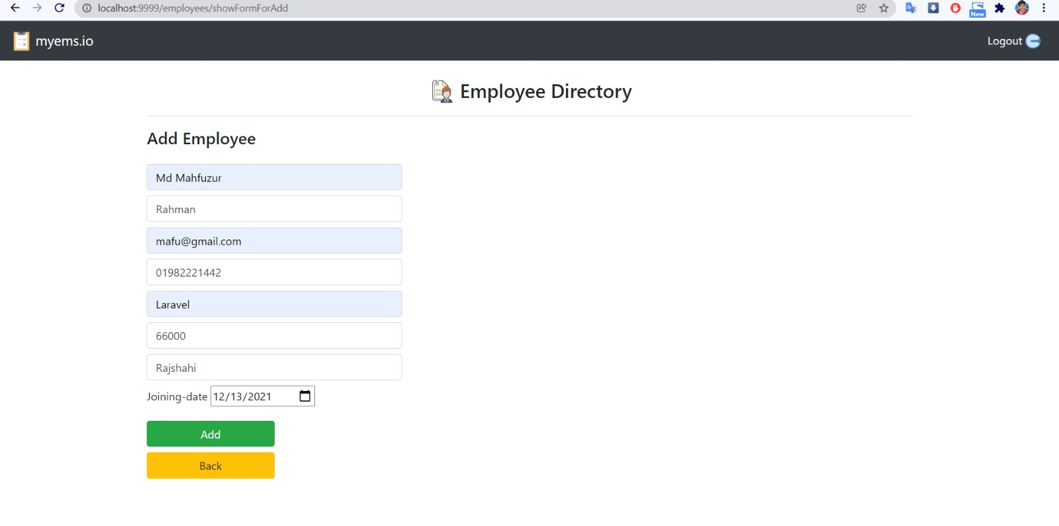
Add employee

Slide 14
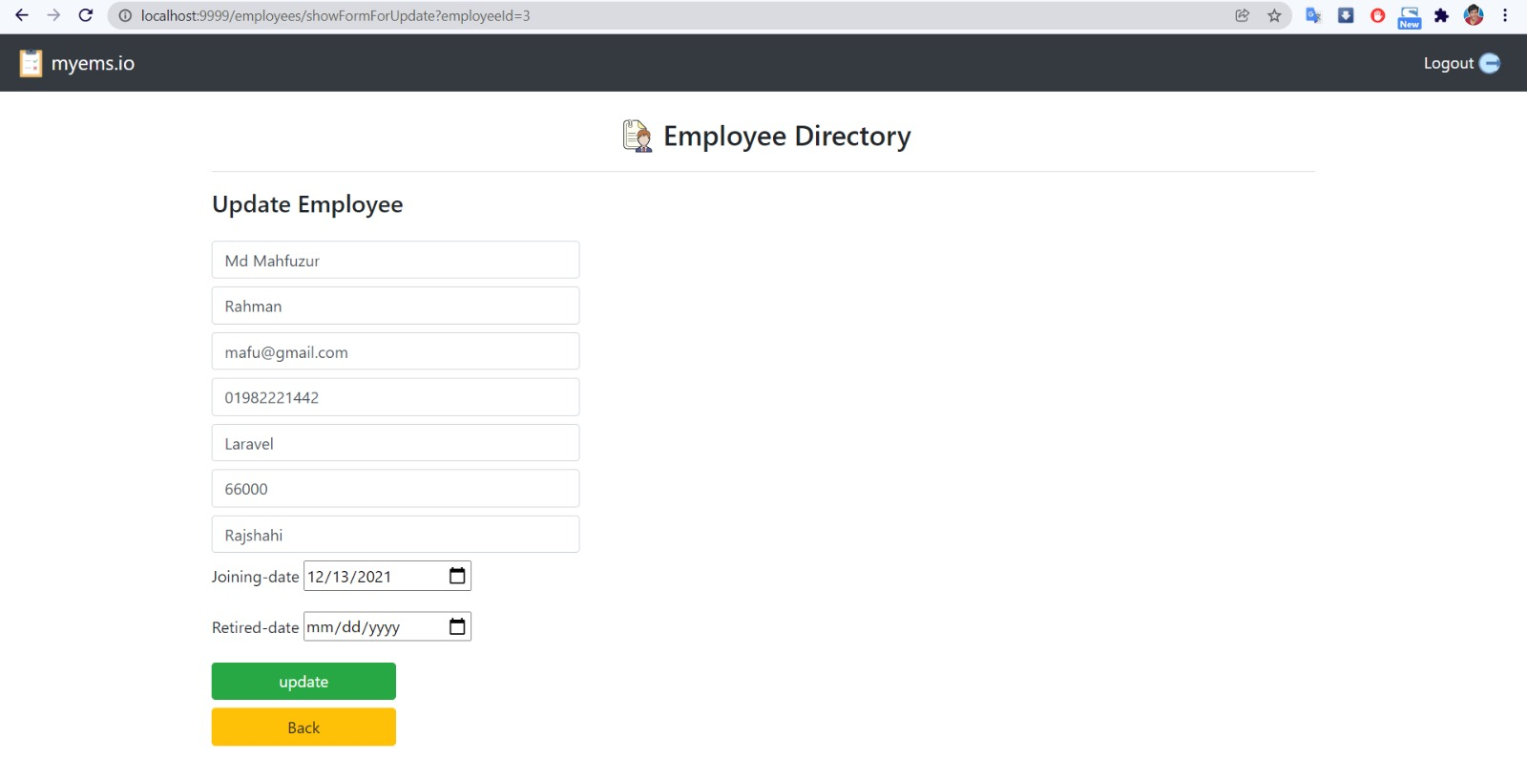
Update employee details

Slide 15
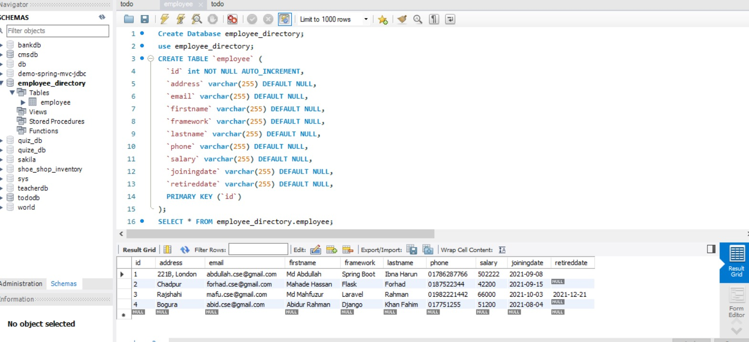
Database in workbench

Slide 16
Challenges faced
Faced error into database issue.
Faced not getting any data from user input.
Front end logical issue.
Faced Some Little bugs.

Slide 17
technology description
Spring boot:
Spring Boot uses sensible default configurations for various components of your application. You can start building your project without spending a lot of time configuring the application context, data source, or web server.
Spring Boot provides a powerful dependency management system. You can declare dependencies in your project’s configuration file (e.g., ‘pom.xml’ for Maven), and Spring Boot will ensure that the correct versions of these dependencies are used, reducing version conflicts.

Slide 18
Maven:
Description: Maven is a build automation and project management tool. It simplifies the build process and manages dependencies in a project. It uses a standardized directory layout and configuration files (pom.xml) to manage and build Java-based projects.
Usage: Maven is used to compile, test, package, and manage dependencies in a Java project. It simplifies the build process and ensures project consistency.
Java:
Description: Java is a widely used, high-level, object-oriented programming language. It's known for its portability, meaning that Java code can run on various platforms without modification. It's used for building a wide range of applications, including web applications.
Usage: Java is the primary programming language for building the backend logic of the Employee Management System. It's used for implementing business logic, data processing, and database interactions.

Slide 19
Thymeleaf:
Description: Thymeleaf is a server-side Java template engine for web applications. It allows you to create dynamic web pages by embedding server-side Java code directly into HTML templates. Thymeleaf templates can be easily integrated with Spring applications.
Usage: Thymeleaf is used for rendering dynamic content in web pages. It simplifies the creation of HTML templates that can display data from the server.
Spring Data JPA:
Description: Spring Data JPA is part of the Spring Data project and simplifies data access and persistence in Spring applications. It provides a high-level abstraction over JPA (Java Persistence API) and allows you to interact with a database using Java objects.
Usage: Spring Data JPA is used for database operations in the Employee Management System. It simplifies CRUD (Create, Read, Update, Delete) operations and reduces the amount of boilerplate code required for database access.

Slide 20
Spring Security:
  Description: Spring Security is a powerful authentication and authorization framework for securing Java-based applications. It provides features for user authentication, access control, and protection against common web application vulnerabilities.
  Usage: Spring Security can be used to secure the Employee Management System, especially if user authentication and authorization are required.
These technologies, when combined, provide a robust and efficient stack for developing web applications like the Employee Management System. They help manage project dependencies, handle web requests, process data, and secure the application.

